Slide 1

Vehicle Fleet Management

Slide 2
Introduction
Before and after
importance of efficient vehicle fleet management in today’s context

Slide 3
Importance of effective vehicle fleet management
Effective vehicle fleet management is crucial for businesses that rely on commercial motor vehicles. Here are some reasons why fleet management is important
Cost Reduction
Improved Safety
Compliance
Increased productivity
Better Customer Service
Longer vehicle lifespan
In summary effective vehicles fleet management can lead to cost savings improved safety, compliance, increased productivity, better customer service,and longer vehicle lifespan.

Slide 4
Key challenges faced by fleet managers
Managing high cost
Supply chain disruption
Fuel Management
Route optimization
Health and Safety issues
Compliance requirements
Maintenance issues
There are just some of the key challenges faced by fleet managers. By understanding these challenges and implementing effective strategies ,fleet managers can help improve the efficiency and profitability of their fleet.

Slide 5
Objective of the presentation
The objective of the presentation on vehicle fleet management is to provide a comprehensive understanding of the key concepts, benefits, and strategies involved in effectively managing a fleet of vehicles

Slide 6
ER Diagram
ER diagram is a graphical representation that decipts the relationship between entities in a databases.
Identify entites
Define attributes
Determine relationship
Specify cardinality
Determine primary keys
Draw entities and attributes
Draw relationships
Add primary and foreign keys
Refine and finalize the diagram

Slide 7
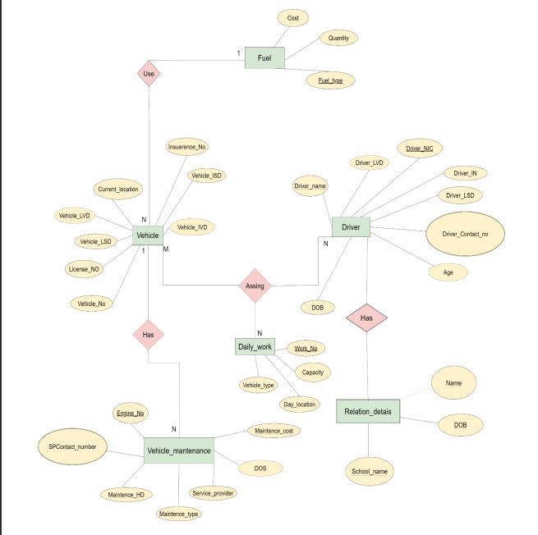

Slide 8
Data Gathering & requirement Annlysics

Slide 9
Relation Schema
A relation schema, also known as a database schema or table schema, defines the structure of a relational database. It describes the organization of data into tables, the attributes or columns within those tables, and the relationships between the tables.
Table Name
Attributes or Column
Primary Key & Foreign Key
Constraint
Indexes
Relationship
Views

Slide 10
Mapping
mapping, also known as database mapping or database schema mapping, refers to the process of representing the structure and relationships of a database schema within a specific database management system (DBMS)
Analyzing the Database Schema
Translating the Schema
Creating the Database
Testing and Validation

Slide 11
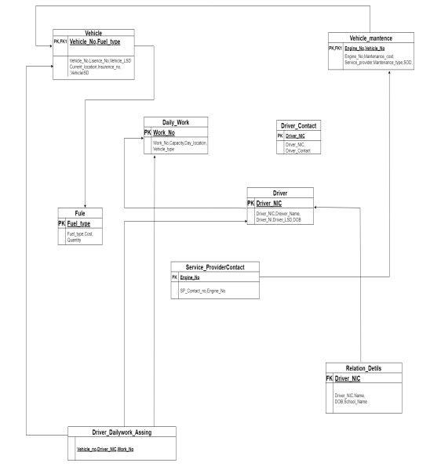

Slide 12
Create Data base & Table
To create a database and table in a database management system (DBMS), the specific syntax and commands may vary depending on the DBMS you are using. Here are examples of creating a database and table in two popular DBMSs:

Slide 13
